Slide 1
Clustering of Traffic Congestion Points
in Bogor City
Mini Project Data Consultant Bootcamp 2023

Slide 2
TABLE OF CONTENT
1
3
5
Problem
Overview
Summary
2
4
Analysis
Flow
Objective
Project
Result

Slide 3


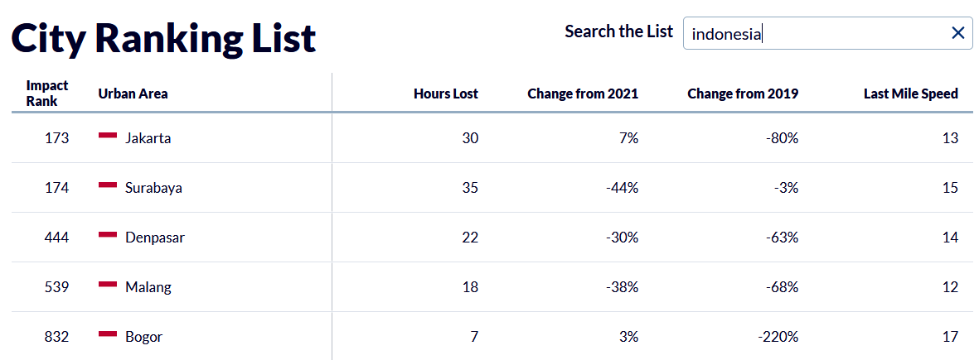
PROBLEM OVERVIEW
Traffic data analysis company, INRIX, released a study titled "Global Traffic Scorecard 2022". The results of this study show that Bogor becomes the fifth most congested city in Indonesia and becomes 832th in global rank with the worst traffic jams from more than 1,000 cities in 50 countries.

Slide 4
OBJECTIVE
Classify the traffic jam severity level of the roads in Bogor city using the clustering method
Provide information to road users in Bogor city which road point often occur the traffic jam
Provide detailed information regarding road names and times when traffic jams occur in the Bogor City

Slide 5
ANALYSIS FLOW
BUSSINESS
UNDERSTANDING
01
02
DATA UNDERSTANDING
DATA CLEANING &
PREPARATION
03
04
CLUSTERING
EVALUATION
05
06
ANALYSIS & VISUALIZATION

Slide 6
TRAFFIC JAM SEVERITY CLUSTER
PROJECT RESULT
1
CRITICAL
3
moderate jam length, highest lost hour, low speed
HIGH
2
2
lowest jam length, moderate lost hour, lowest speed
4
3
MEDIUM
highest jam length, low lost hour, high speed
1
LOW
4
moderate jam length, lowest lost hour, high speed

Slide 7
METRICS OF ALL CLUSTERS
 | CLUSTER | AVG JAM LENGTH (m) | AVG LOST HOUR (second) | AVG SPEED (km/h) | ROAD POINTS AMOUNT
01 | Critical | 747.0 | 265.75 | 7.370 | 179
02 | High | 279.0 | 129.00 | 5.685 | 403
03 | Medium | 1263.0 | 84.50 | 21.500 | 87
04 | Low | 591.0 | 85.00 | 12.620 | 255

Slide 8
TOL BOCIMI IS CRITICAL ROAD POINT CLUSTER
THAT HAVE LONGEST TRAFFIC JAM LENGTH
TOP 5 LONGEST JAM LENGTH
Tol Bocimi
1ST
3,329 km, occur around 19.00 o’clock
Tol Lingkar Luar Bogor
2ND
1,623 km, occur around 06.00 - 22.00 o’clock
N9 Jalan Raya Tajur
3RD
1,541 km, occur around 06.00 - 22.00 o’clock
N9 Ir Haji Juanda
4TH
1,431 km, occur around 00.00, 03.00, 06.00-08.00, 10.00-20.00 o’clock
Tol Jagorawi
5TH
1,424 km, occur around 05.00 - 00.00 o’clock

Slide 9
CILENDEK TIMUR IS CRITICAL ROAD POINT CLUSTER
WITH HIGHEST LOST HOURS
TOP 5 HIGHEST LOST HOURS (IN MINUTES)
23,76’
18,5’
16,18’
16,11’
14,28’
Cilendek Timur
Tol Bocimi
Bina Marga 2
Rumah Sakit 1
Jalan Pabuaran

Slide 10
THE HIGHEST SPEED WHEN YOU PASS THE CRITICAL ROAD POINT IS JUST
TOP 5 HIGHEST SPEED (IN KM/ HOUR)
14,11
12,37
12,00
11,84
11,82
km/hour
km/hour
km/hour
km/hour
km/hour
1
2
3
4
5
Jalan Kampung Mulyasari
Bojongkerta Rancamaya
Tol Lingkar Luar Bogor
N9 Ir Haji Juanda
Arah Sentul Selatan/Tol Lingkar Bogor/Jakarta

Slide 11
There are 4 clusters of traffic jam severity level
POINT 1
The clusters is critical, high,medium,and low level
SUMMARY
POINT 2
There are 179 road point that include in critical cluster
Tol bocimi is road point that have the highest jam length
POINT 3
Cilendek Timur is road point that have the highest lost hour

